Slide 1

Balanced scorecard slide 1
HOME POWER CONSUMPTION
ANALYTICS FOR ENERGY REDUCTION
JESSICA KRUEGER – IOT ANALYTICS

Slide 2






Balanced scorecard slide 3
REPORT SUMMARY
#1: Market Sub-meters As Energy Reduction Tool
#4: Create Forecasting Tool and Interactive App
#2: Appliance Performance Tracking
#3: Install Efficient Water Heaters In All Homes
Process and Data Set Review

Slide 3
Balanced scorecard slide 6
OUR DATA SCIENCE PROCESS
The Business Question
Analysis Plan
Data Collection
Insights
Recommendations
Notes:
We can create such a model using this process

Slide 4
Balanced scorecard slide 6
ENERGY CONSUMPTION DATA SET
Electric Consumption Data Set
Data every minute from:
Dec 2006 to Nov 2010
4 Sub-Meters:
Kitchen
Laundry Room
Water Heater & A/C
Rest of House
2 Million+ observations
1.25% missing values
Notes:
The data we have is the Electric Consumption Data Set
Rich data set
Over 2 million observations of 4 submeters in one home
Better to have multiple homes, but this is good start
The consumption measured every minute for 47 months
25,000 missing minutes

Slide 5
RECOMMENDATION #1
Market Sub-meters As Energy Reduction Tool
Notes:
When you install sub-meters in new homes, market them as an energy reduction tool

Slide 6
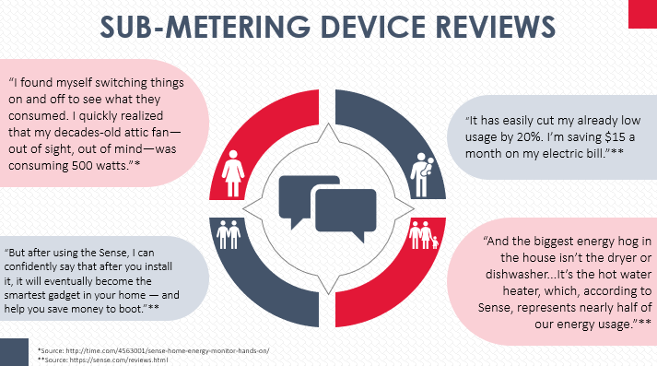
Reviewers Say Sub-meters Save Them Money
Notes:
Recall from our first presentation, reviews from current users say they these devices save them money.

Slide 7
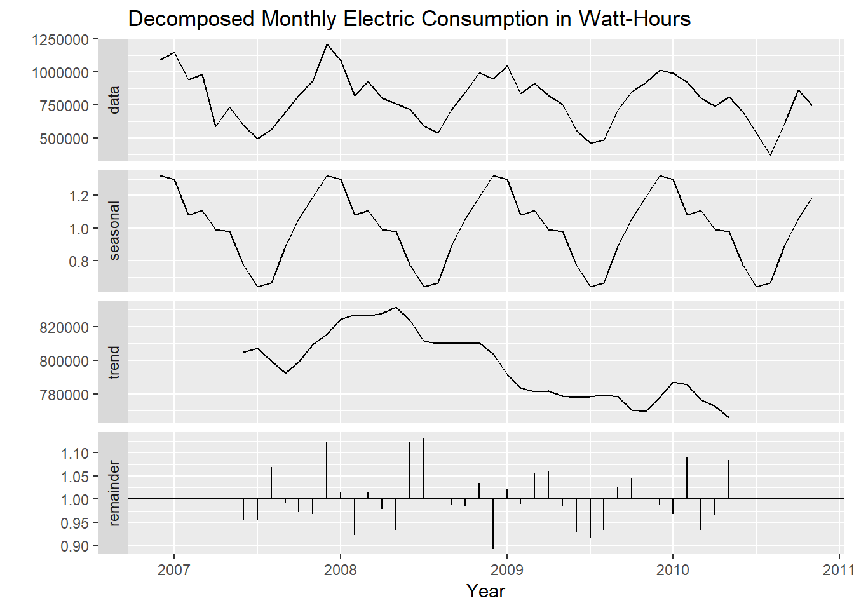
Household Energy Consumption is Trending Down
Notes:
We can confirm this with the data set we have.
There is a trend of reduced consumption over time.
Correlation isn’t causation, so we cannot say for sure that the reduction is because of the submeters

Slide 8
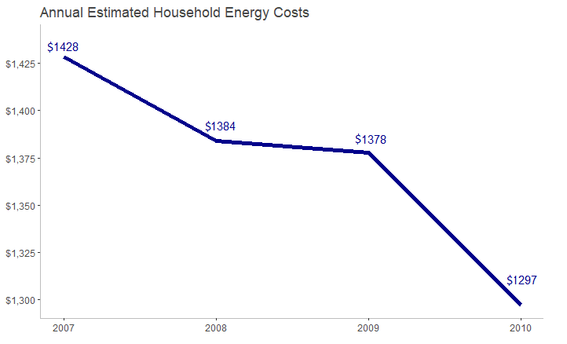
Household Energy Costs Are Decreasing
10%
Notes:
It would follow that if consumption is going down,
the household energy bill would also be going down.
So the submeters can help you use less energy and save money.

Slide 9
RECOMMENDATION #2
Promote Appliance Performance Tracking
Notes:
When marketing the submeters,
promote idea that you can track performance of appliances

Slide 10
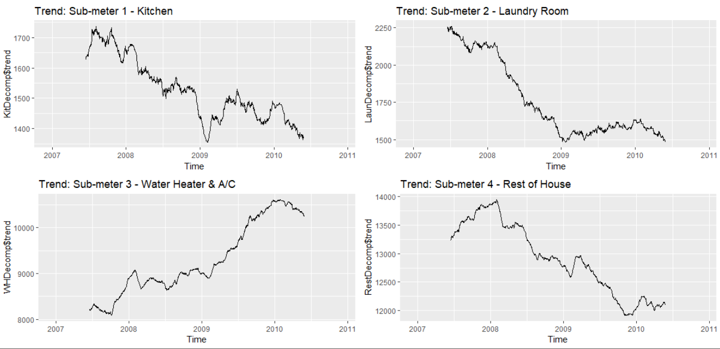
Consumption for Sub-meter 3 is Increasing
Notes:
This chart shows us the trend of each submeter.
We can see all submeters are trending down except for the water heater & A/C submeter

Slide 11
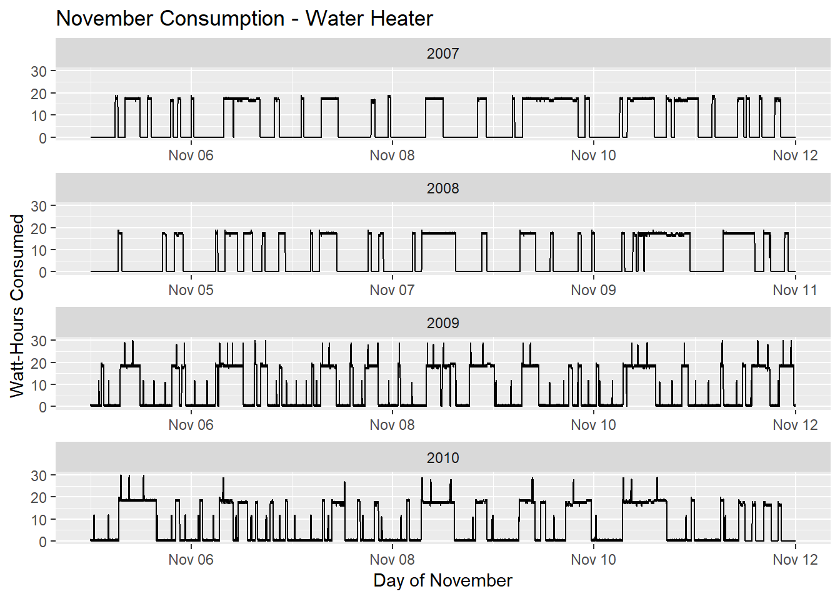
Water Heater Performance is Declining Over Time
Water Heater Electric Consumption by Minute – Week 45
2007
Active: 63 hours
Max = 19 w-h
A closer look…
November 6-12
2010
Active: 126 hours
Max = 30 w-h
Notes:
Took a random sample of one week in November for all years 2007-2010
Might look like musical scales, but this is actually the isolated water heater electric consumption
No A/C during this time, so we can see what the water heater is doing
Change in usage really jumps out at you in this chart
In 2007, it’s active for less time and uses less energy each time it’s active
In 2010, it’s active twice as much and the max consumption is up by 50%
This pattern exists for randomly sampled weeks in January, February, and March as well

Slide 12
Possible Explanations for Declining Performance
Water heater is using more energy over time
More people in the house?
Higher temperature setting?
Efficiency declining?
Service might be needed?
Replace water heater?
Lower the setting
A closer look…
November 6-12
Notes:
With this info, we conclude that water heater is using more energy over time
Could be a few explanations
More people in house?
Higher temp setting?
Good to know what a change like this can mean for your usage/bill
Performance degrading?
Might be time to service or replace the water heater

Slide 13
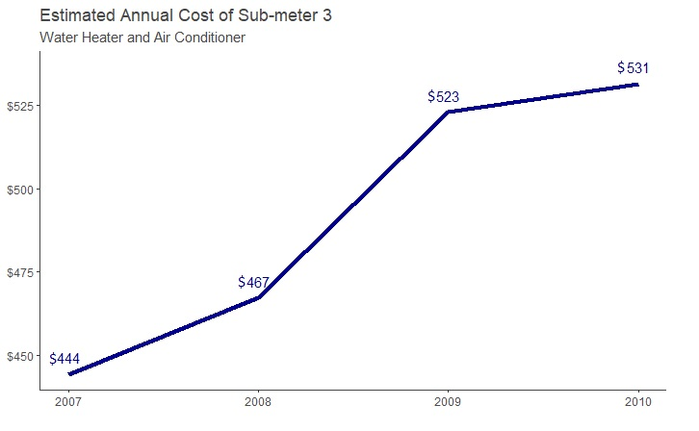
Water Heater In-efficiency Costs More Money
20%
Notes:
With this data, we can also tell homeowner how much the cost of these appliances is going up each year.
May not seem significant now, but it’s 20% increase
The trend is likely to continue
Water heater will continue to use more energy and cost more money

Slide 14
RECOMMENDATION #3
Install Efficient Water Heaters In All Homes

Slide 15
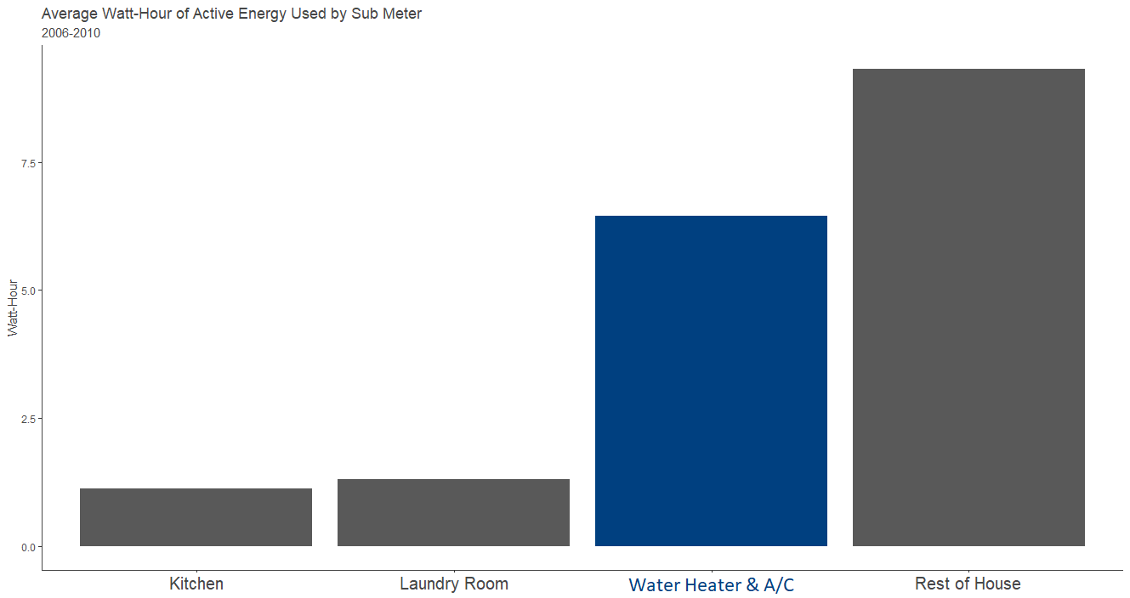
Water Heaters Use the Most Energy in a Home
Water heaters are a home’s most expensive appliance to operate
Air Conditioner
Avg: 300 w-h/day
Water Heater
Avg: 1200 w-h/day
source: http://energyusecalculator.com
Notes:
Water heater is the most used appliance in the house and it uses the most energy.
Installing highly efficient water heaters is the easiest way to reduce consumption and the electric bill.
If your budget is limited when it comes to appliances, energy efficient water heaters will provide the most value.

Slide 16
RECOMMENDATION #4
Create Forecasting Tool and Interactive App

Slide 17
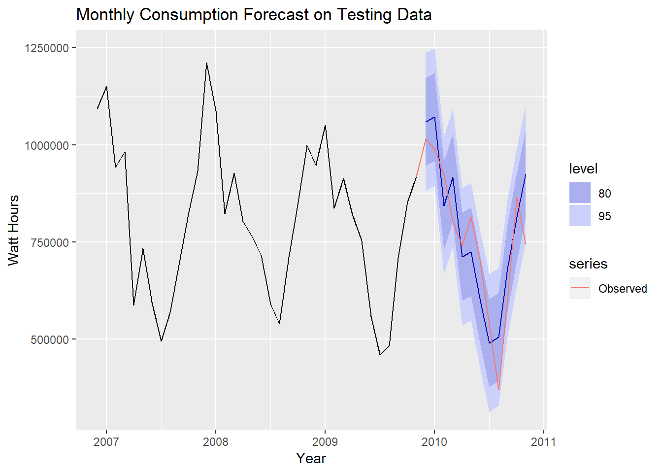
Linear Forecasting Model Can Be Used Predict Consumption
Accuracy Metrics
RMSE: 63230 = 63 kWh
MAPE = 7.128
Residuals = white noise
Notes:
Using this data set, we were able to create a reasonable forecasting model after testing several model types
We split the data into training and testing set
Train model on the training set
Test the model’s accuracy on the testing set.
Many models tested, pick the one that minimizes the error metrics
The final model is a linear regression model using trend & seasonality as predictors
We can see it performs pretty well
Just because model fits the sample data well, doesn’t mean it will forecast well though!

Slide 18
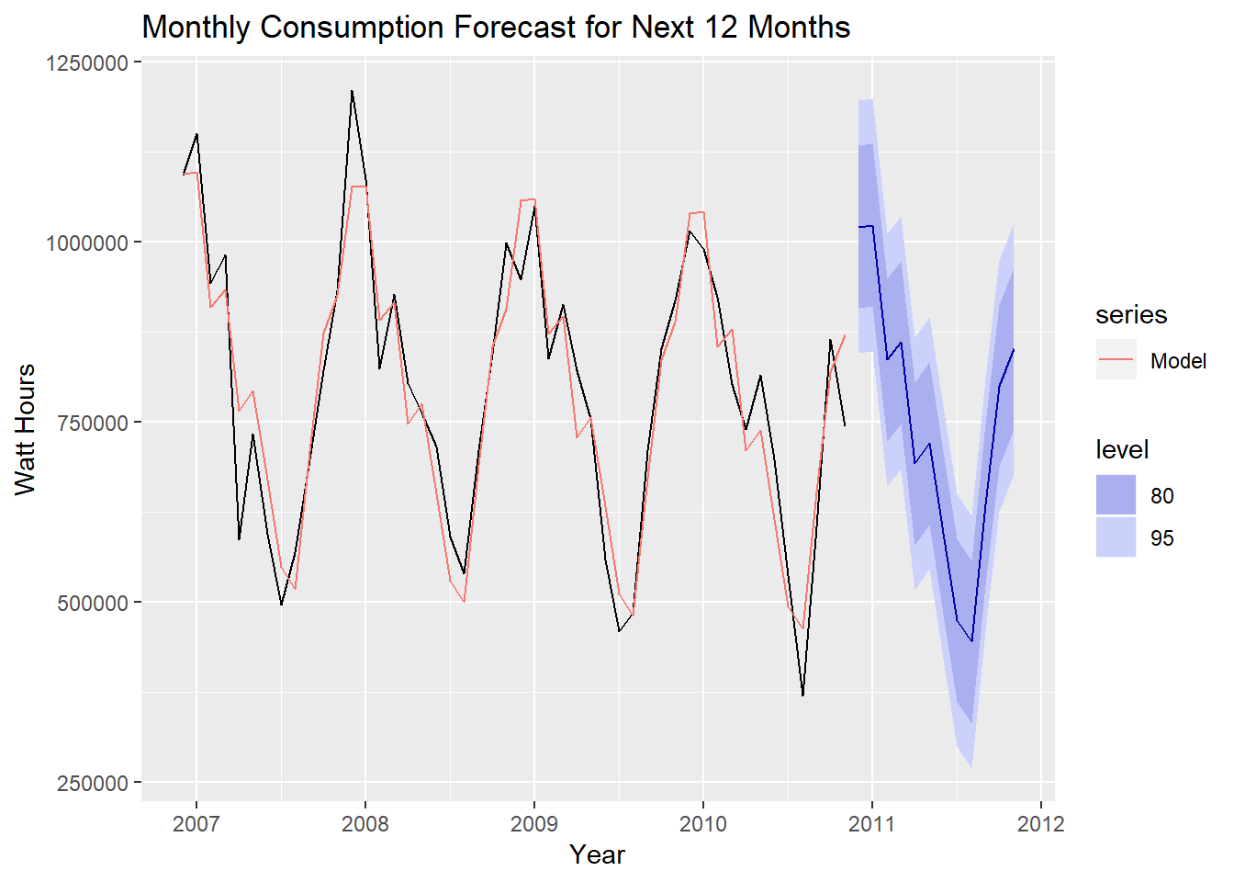
Energy Consumption Forecast for Next 12 Months
Notes:
Here is the model used to create a forecast for the next 12 months
This looks reasonable given the past data
The blue line is our point forecast, or the specific value we are predicting
But we also include the 80 and 95 % prediction intervals to show where we feel confident that the actual value will fall

Slide 19
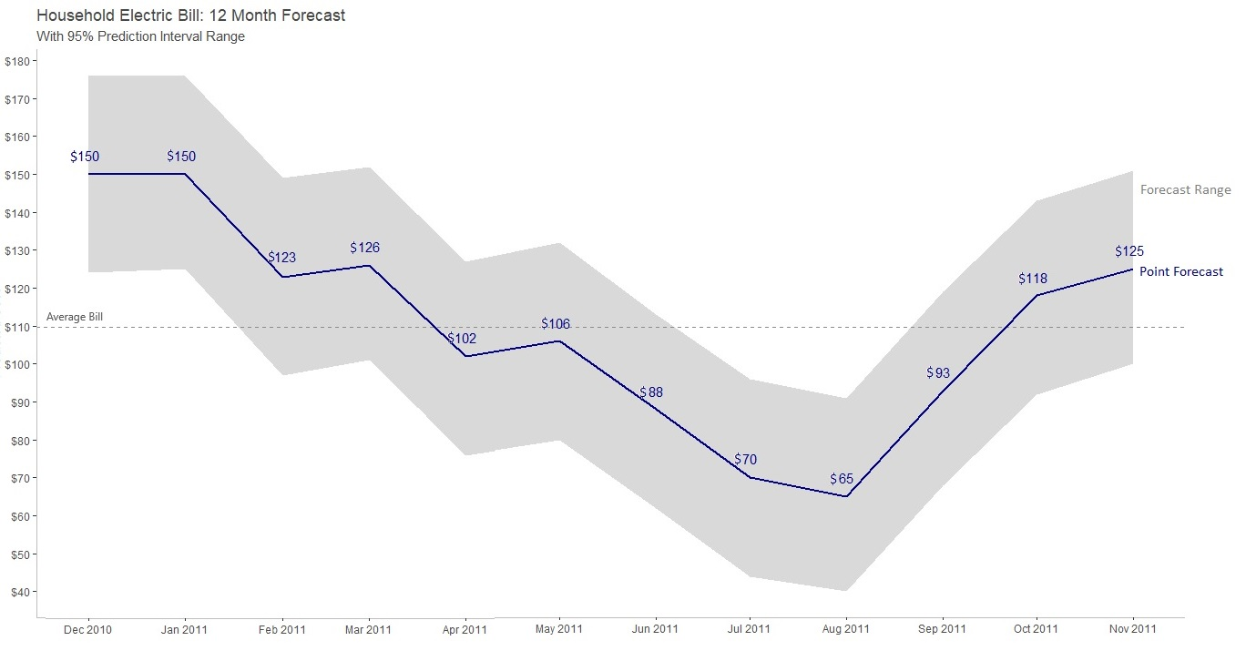
Predict Next 12 Months of Energy Bills
Notes:
Using forecasts generated from the model, we can predict the homeowner’s monthly bill
This chart shows our point forecast as well as the 95% prediction range
Where we can say the actual value will fall with 95% probability
By showing if the bill is below or above average, the homeowner can know how the bill relates to other months in the year
By giving a long term forecast, families can better budget their monthly expenses

Slide 20

Compare Prediction to Last Year’s Data
Notes:
Using forecasts generated from the model, we can predict the homeowner’s monthly bill
This chart shows our point forecast as well as the 95% prediction range
Where we can say the actual value will fall with 95% probability
By showing if the bill is below or above average, the homeowner can know how the bill relates to other months in the year
By giving a long term forecast, families can better budget their monthly expenses

Slide 21


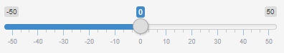
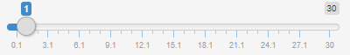
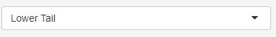


Sample Interactive Energy Dashboard
Personal Energy Dashboard
Current kWh Cost: $.187
Forecast Period
Comparison Period
Sub-meter
Measure
Entire House
ENERGY RECOMMENDATIONS
Wait until kWh cost goes down to use dishwasher
Save money by lowering water heater temperature
Dollars
Notes:
Of course, having all of this information in an interactive format would be the most useful
An app could contain the following features:
Usage and bill forecast
Cost of electricity right now (help with peak shifting)
Recommendation on when and when not to use dishwasher, washer/dryer, etc
Comparisons to previous month/year’s usage
Appliance tracker
Recommendations to reduce consumption

Slide 22
Balanced scorecard slide 3
RECOMMENDATION SUMMARY
Market Sub-meters As Energy Reduction Tool
Create Forecasting Tool And Interactive App
Promote Appliance Performance Tracking
Install Efficient Water Heaters In All Homes
Notes:
Sub meters help people reduce consumption and save money. Powerful marketing tool for your new homes.
The ability to track appliance performance gives people insight into their usage and what appliances are costing them the most
By installing highly efficient water heaters, you’re providing the most value to a homeowner in terms of efficient appliances
An energy forecast along with an interactive app puts the power of all this data directly into the hands of the homeowner so that she can reduce consumption and save money.

Slide 23



Balanced scorecard slide 10
QUESTIONS?
JESSICA KRUEGER
+1 (555) 123-4567
Jessica@iotanalytics.com

